Slide 1
Adverse Childhood Experiences in Minnesota
Findings from the 2013 Minnesota Student Survey

Slide 2
MN State Epidemiological Outcomes Workgroup
Monitor trends in substance use and related factors, including mental health
Improve access to substance use data
Provide epidemiological training and technical assistance

Slide 3
ACEs
Adverse childhood experiences (ACEs) are stressful or traumatic experiences, including abuse, neglect and a range of household dysfunction

Slide 4
Minnesota student survey

Slide 5
The Survey
Census survey on a wide variety of youth behaviors, perceptions, and risk and protective factors related to health, safety, and academics
Collaboration between Minnesota Schools and the Minnesota Departments of Education, Health, Human Services, and Public Safety

Slide 6
2013 MSS
Administered in the first half of 2013 to public school students in grades 5, 8, 9, and 11
84% of public operating school districts participated
Overall participation across the four grades was approximately 67% of total enrollment

Slide 7
Seven* ACE Items
Incarcerated parent/caregiver
Living with someone who drinks too much alcohol
Living with someone who uses illegal drugs or abuses prescription drugs
Verbal abuse
Physical abuse
Household domestic abuse
Sexual abuse
*Some people include additional items, such as measures of poverty and/or dating violence

Slide 8
Survey Changes
Parent incarceration and verbal abuse added in 2013
Questions about household substance use changed in 2013 (previous questions asked about negative consequences due to use)
Not all questions asked of 5th graders; ACE items dropped in 2016 for this grade

Slide 9
Prevalence of aces

Slide 11
8th graders were as likely as 11th graders to report 4+ ACEs

Slide 12
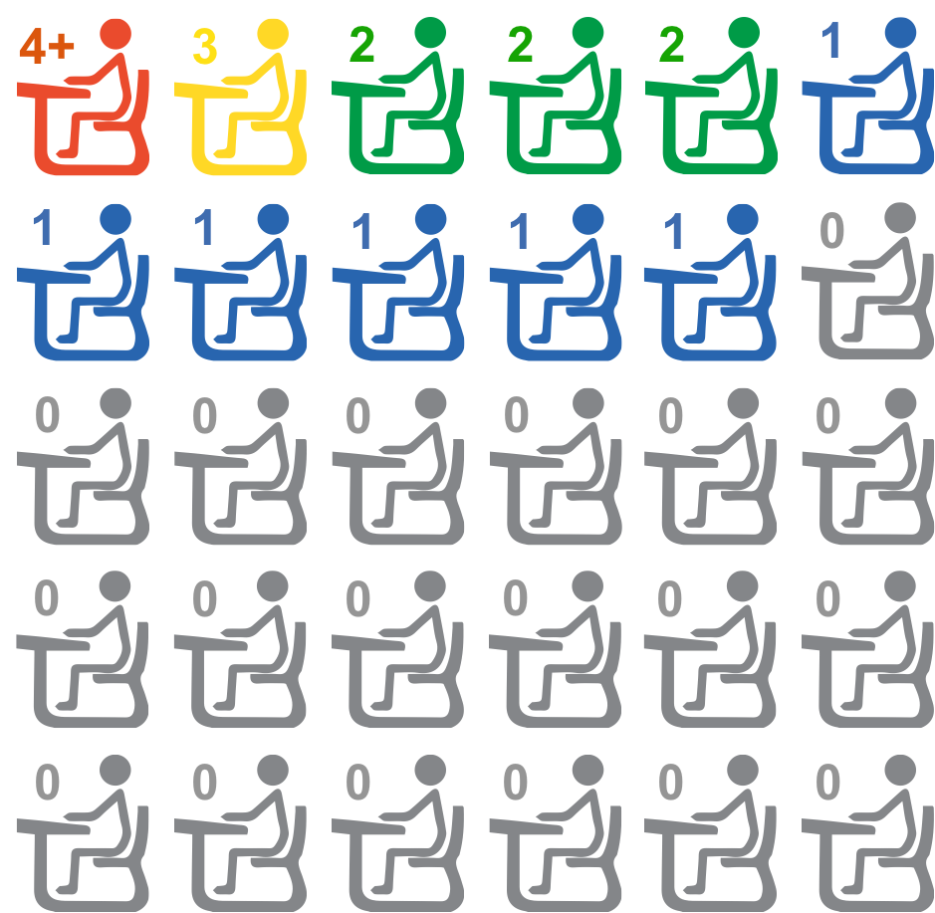
Distribution of ACEs in an average MN 11th grade classroom

Slide 13
Percentage of Minnesota Students Reporting
Zero ACEs, 2013
Kittson
Roseau
Lake of the
Woods
Marshall
Koochiching
Pennington
Beltrami
Cook
Red Lake
Saint Louis
Polk
Clearwater
Itasca
Lake
67% to 77%
Norman
Mahnomen
Hubbard
Cass
Clay
Becker
Wadena
Aitkin
Carlton
64% to 66%
Wilkin
Otter Tail
Crow
Wing
Todd
Mille
Lacs
Pine
Grant
Douglas
Morrison
Kanabec
60% to 63%
Traverse
Stevens
Benton
Isanti
Big Stone
Pope
Stearns
Sherburne
Chisago
Swift
Kandiyohi
Anoka
47% to 59%
Lac qui
Parle
Chippewa
Meeker
Wright
Hennepin
Washington
McLeod
Carver
Ramsey
Yellow Medicine
Renville
Scott
Dakota
Lincoln
Lyon
Redwood
Sibley
Goodhue
Nicollet
Le Sueur
Rice
Wabasha
Murray
Brown
Blue
Earth
Waseca
Dodge
Pipestone
Cottonwood
Watonwan
Steele
Olmsted
Winona
Rock
Nobles
Jackson
Martin
Faribault
Freeborn
Mower
Fillmore
Houston
*No data for Chippewa County

Slide 14
Students Reporting 1+ ACEs
By gender
By race/ethnicity
Females: 38%
Males: 33%
American Indian: 62%
Bi-/Multi-racial: 54%
Hispanic: 50%
Pacific Islander: 49%
Black and African-born: 48%
Asian: 39%
White: 31%

Slide 15
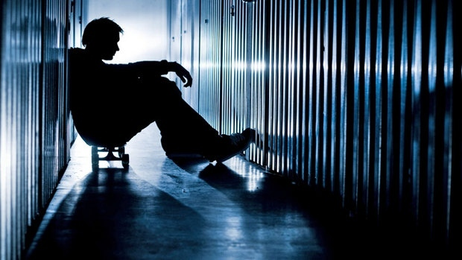
ACEs + mental health

Slide 16
Mental Health among Minnesota’s 8th, 9th, and 11th Graders
Depression: 37%
Anxiety: 40%
Self-harm: 21%
Suicidal ideation: 15%
Depression: 20%
Anxiety: 23%
Self-harm: 9%
Suicidal ideation: 7%

Slide 17
ACES + Past Year Mental Health Issues

Slide 18
ACES + Suicidal Ideation/Attempt

Slide 19
ACEs + Substance use

Slide 20
ACES + Past Month Substance Use

Slide 21
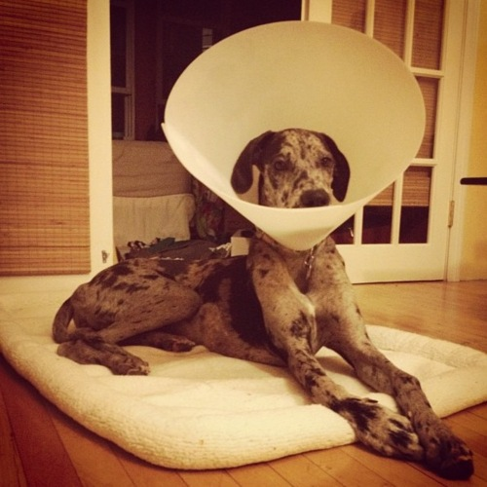
Protective factors

Slide 22
Protective Factors
Individual resilience and environmental influences/circumstances associated with a reduction in the likelihood of substance use and mental health disorders
Buffer the impact of risk factors like ACEs
Can be enhanced within families and communities

Slide 23
Societal
Community
Relationship
Individual
Notes:
Individual risk and protective factors are influence by relationship factors (i.e., peer relationships, family relationships), community factors (i.e., school engagement and bonding, neighborhood safety and caring), and societal factors (i.e., social and economic policies, discrimination, etc.)

Slide 24
Family
Among students with 2+ ACEs…
those who can talk to their mother and/or father “most” or “some” of the time about problems they are having are 1.7x less likely to report past year suicidal ideation
those who feel their parents care about them “very much” or “quite a bit” are 2.1x less likely to report past year suicidal ideation

Slide 25
Schools
Educational Engagement
Student-Teacher Relationships
How often do you care about doing well in school?
How often do you pay attention in class?
How often do you go to class prepared?
If something interests me, I try to learn more about it.
I think the things I learn at school are useful.
Being a student is one of the most important parts of who I am.
Overall, adults at my school treat students fairly
Adults at my school listen to the students
The school rules are fair
At my school, teachers care about students
Most teachers at my school are interested in me as a person

Slide 26
Schools
Among students with 2+ ACEs…
those with greater educational engagement are less likely to report suicidal ideation (25% vs. 35%) and depression (54% vs. 63%)
those with better student-teacher relationships are less likely to report suicidal ideation (23% vs. 33%) and depression (51% vs. 62%)

Slide 27
Communities

Slide 28
Accessing the data

Slide 29
Minnesota Department of Education
education.state.mn.us
Data Reports and Analytics
Scroll down to Student Data > Minnesota Student Survey
Encourage your district to participate if they don’t already!

Slide 30
SUMN.org

Slide 31
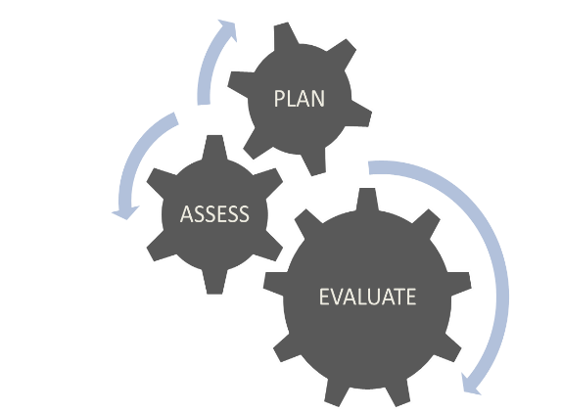
Contact
Melissa Adolfson
EpiMachine, LLC
mboeke@epimachine.com
EpiMachine

